Slide 1
BASIC CHEMISTRY
Chapter 2

Slide 2
UNIT 2 OBJECTIVES
Describe the relationship between atomic structure and subatomic particles.
Identify and evaluate atomic numbers and mass numbers using the periodic table.
Explain the organization of atoms, molecules, and compounds.
List and describe the different types of bonds that form between elements.
Compare and contrast polar and non-polar covalent bonds.
Explain how the properties of water are vital to life.
Distinguish between acids and bases using the pH scale.

Slide 3
Chemistry: natural science that deals with composition, structure, and properties of substances and the transformations they undergo
Numerous branches – Some examples:
Inorganic chemistry – study of compounds that do not necessarily contain carbon and hydrogen
organic chemistry – study of compounds that contain carbon and hydrogen
biochemistry – study of chemical processes within living organisms

Slide 4
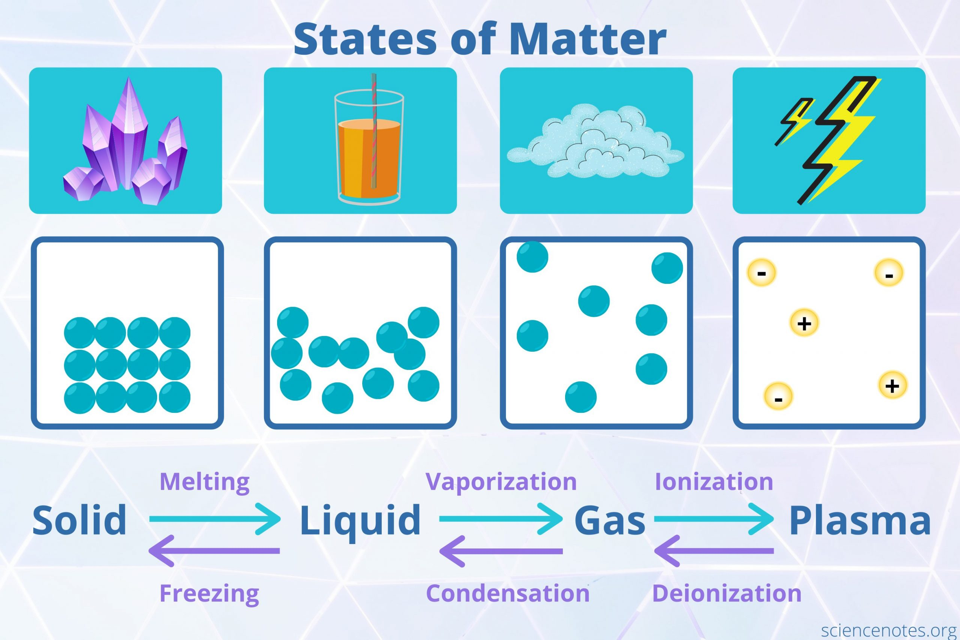
STATES OF MATTER
Matter – anything that takes up space and has mass
Solid – atoms strongly bonded, Repeating patterns
Liquid – Molecules weakly bonded, free to move
Gas – Molecules not bonded to one another, free to move
Plasma – molecules broken apart

Slide 5
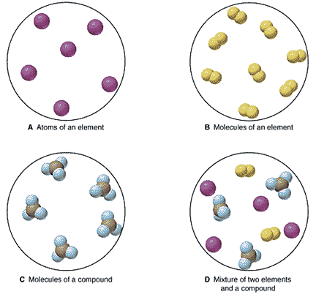
Atoms, elements, compounds
Atom – smallest particle of element that displays properties of element
Element – cannot be broken down into smaller parts with different properties; MADE of only one type of atom
Molecule –two or more of same ATOM bonded together
Compound – two or more different atoms bonded together

Slide 6
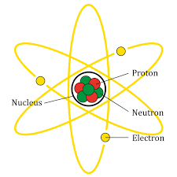
THE atom
3 subatomic particles
Inside nucleus
Proton – positive charge
Neutron – neutral charge
Outside nucleus (in energy levels/shells)
Electron – negative charge

Slide 7
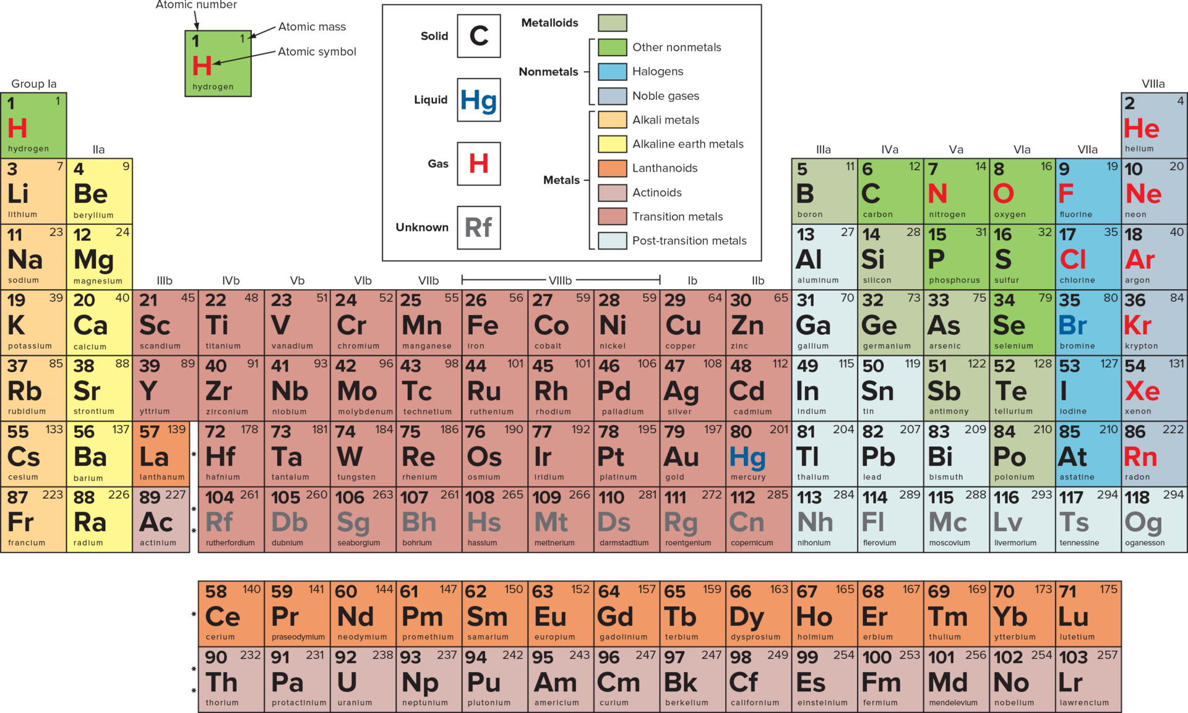
The Periodic table of elements

Slide 8
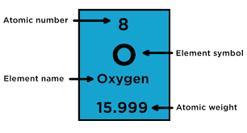
HOW to read the periodic table
element name and symbol
Atomic number = number of protons, never changes
Atomic mass = number of particles in nucleus = protons + neutrons
ATOMS ARE neutral; (+) must balance (-)
protons = electrons
oxygen
Atomic number = 8
8 Protons
8 electrons

Slide 9
HOW to read the periodic table
oxygen
Atomic number = 8
= 8 protons
= 8 electrons
Atomic mass = 16
= 16 Protons & Neutrons together
Neutrons = 16 (mass) – 8 (atomic Number)
= 8 neutrons

Slide 10
DETERMINING PARTICLE NUMBERS
NITROGEN
POTASSIUM
BROMINE
GALLIUM

Slide 11

possible teas questions
The number of protons is the same as?
the number of isotopes for the element
the nuclear force
the angular momentum
the atomic number
which of the following is true about protons?
they have a negative charge
they have more mass than a neutron
the number of protons in the nucleus is the defining property of an element
some atoms have no protons

Slide 12
possible teas questions
The number of protons is the same as?
the number of isotopes for the element
the nuclear force
the angular momentum
the atomic number
which of the following is true about protons?
they have a negative charge
they have more mass than a neutron
the number of protons in the nucleus is the defining property of an element
some atoms have no protons

Slide 13
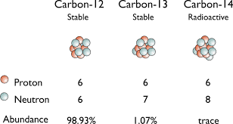
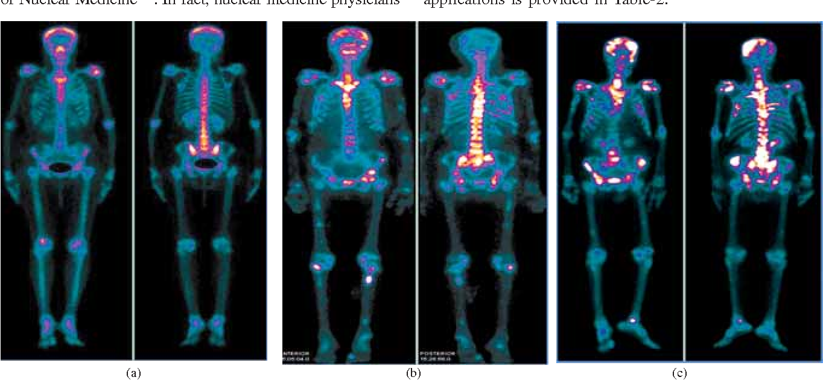
isotopes
Atoms of same element with different number of neutrons
protons and electrons do not change
Radioactive isotopes
Unstable – give off radiation that can be detected
Used to date objects, create images, track movement of substances in the body

Slide 14
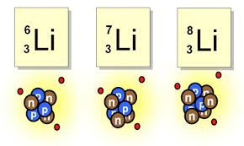
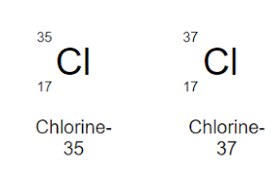
CALCULATING PARTICLES IN ISOTOPES

Slide 15
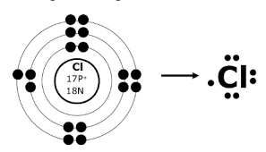
electrons
Located outside nucleus in electron shells
1st shell – 2 electrons
2nd – 8th shell – stable with 8 electrons
Octet rule
Valence shell – outermost shell
LEWIS DOT DIAGRAM
BOHR MODEL

Slide 16
Practice drawing atom diagrams
Carbon phosphorus
Calcium helium

Slide 17
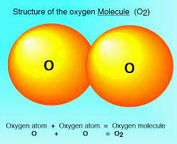
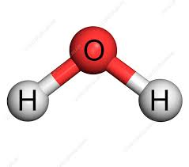
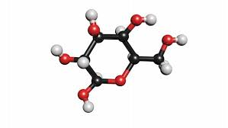
MOLECULES AND COMPOUNDS
Oxygen gas
O₂
Molecule
Water
H₂O
Compound
Glucose
C₆H₁₂O₆
Compound
Molecule – 2 or more of same atom
Compound – 2 or more different atoms
Formula – identifies number of each type of atom

Slide 18
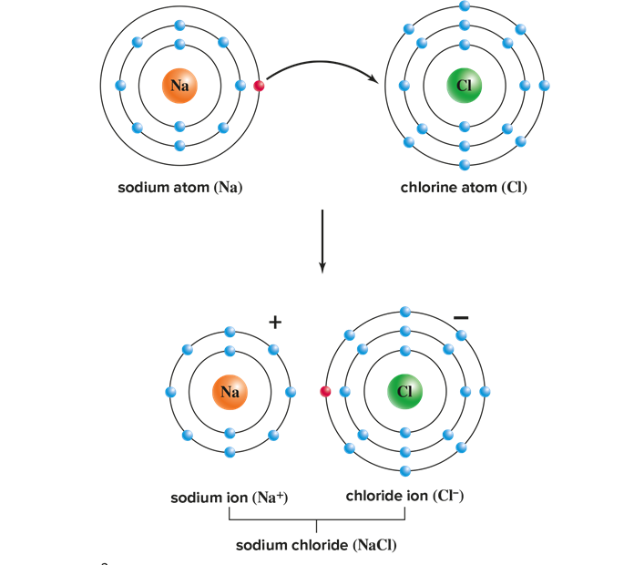
IONIC BONDING
Atoms need 8 electrons in valence shell to be stable
Will donate or accept electrons from other atoms to make 8
Form Ions – charged particles
Give up electrons – become (+) charged
Gain electrons – become (-) charged
involves metal and nonmetal

Slide 19
IONIC BONDING PRACTICE
POTASSIUM BROMIDE
MAGNESIUM IODIDE
LITHIUM OXIDE

Slide 20
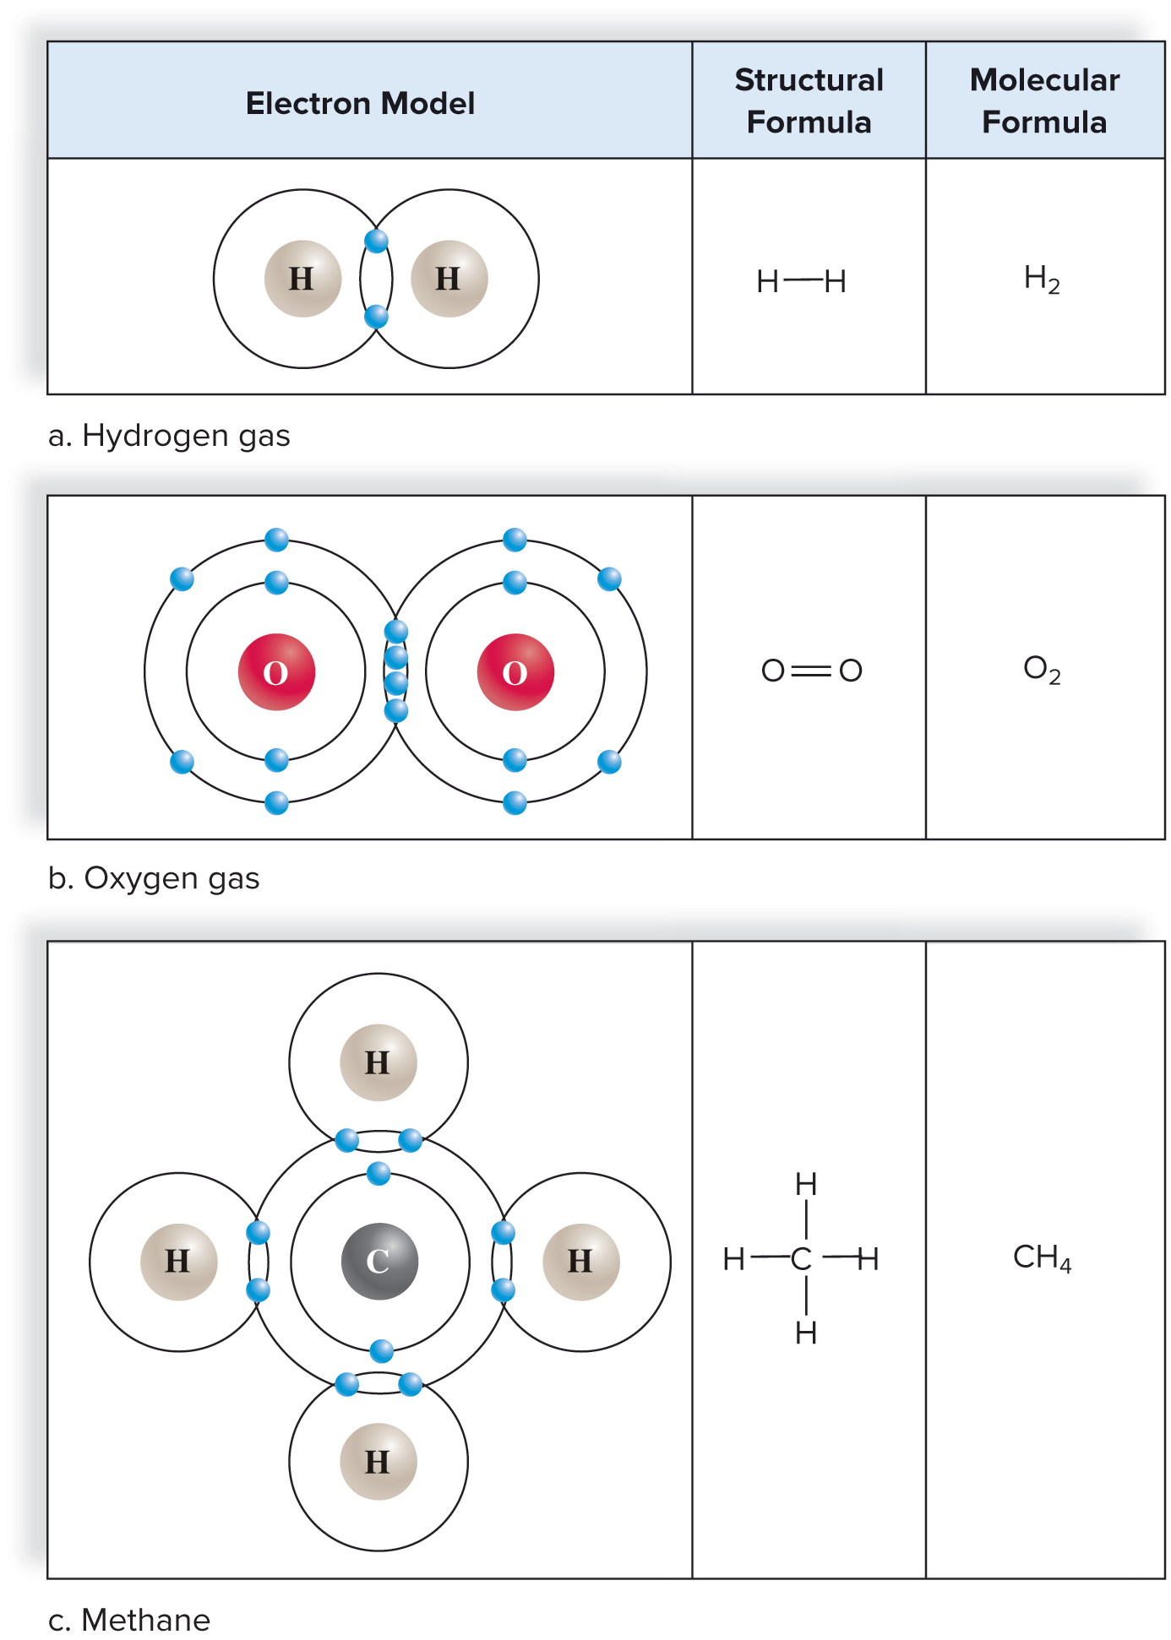
COVALENT BONDING
Atoms share electrons to have stable valence shell
“I need, I share”
Can form:
Single bond – each atom shares one electron
Double bond – each shares two
Triple bond – each shares three
involves 2 nonmetals

Slide 21
COVALENT BONDING PRACTICE
HYDROGEN GAS
NITROGEN GAS
WATER
HYDROGEN FLUORIDE

Slide 23
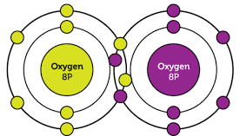
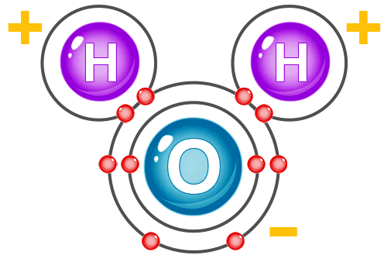
POLARITY distribution of charges over bonded atoms
NONPOLAR COVALENT BOND
Electrons shared equally
Diatomic molecules
POLAR COVALENT BOND
Electrons shared unequally
One atom attracts electrons to greater degree

Slide 24
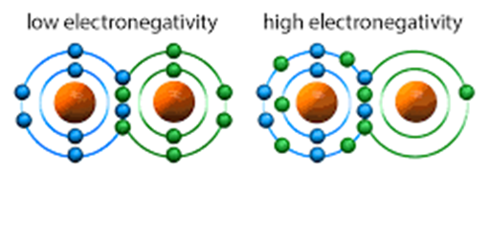
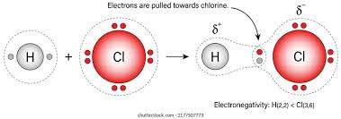
electronegativity
measure of how strongly an atom attracts electrons
stronger attraction = greater electronegativity
Creates + end and - end

Slide 25
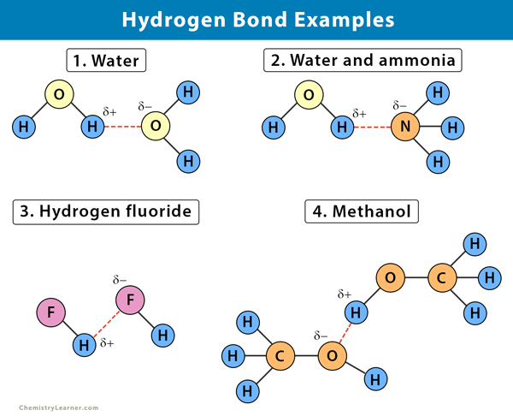
Hydrogen bonding
Weak attraction between 2 polar molecules
Hydrogen (+ end) is attracted to – END of another molecule
drawn as dotted line

Slide 26
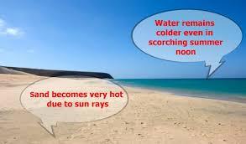
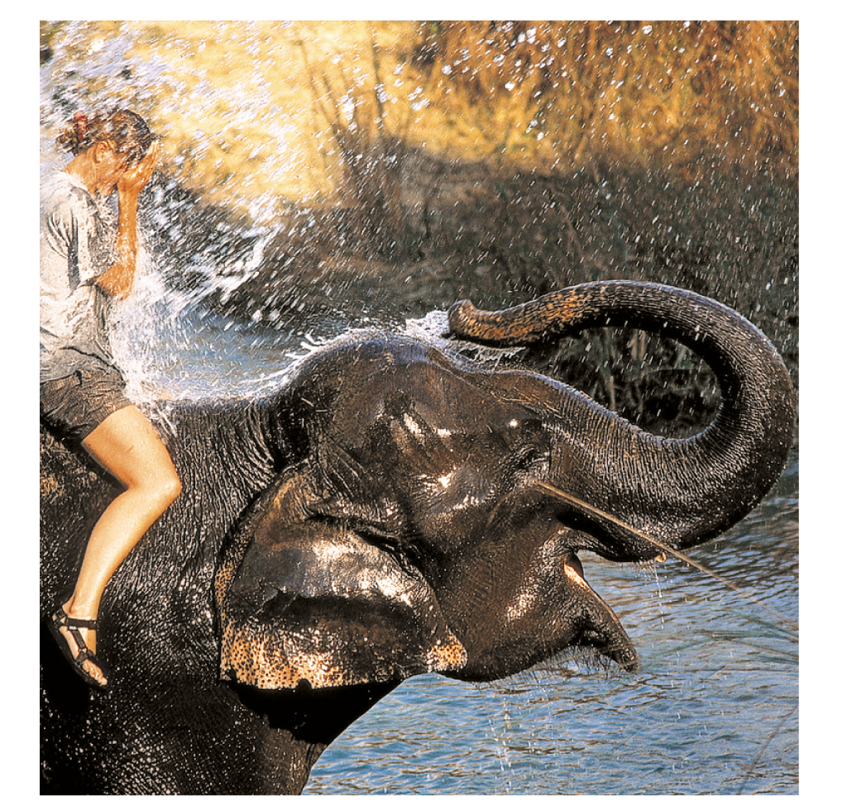
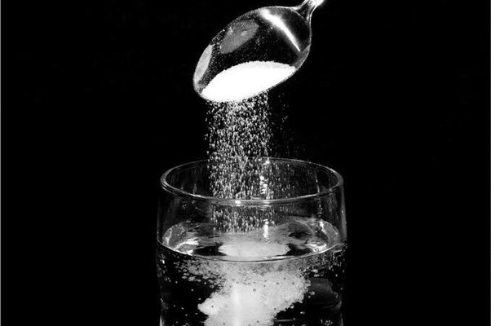
CHEMISTRY OF WATER
Essential to all living organisms
High heat capacity
Holds on to heat; temperature changes slower than other liquids
High heat of vaporization
Cools environment where evaporation takes place
solvent
Dissolves numerous substances; often used in living systems

Slide 27
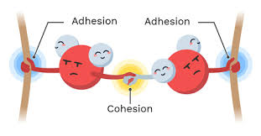
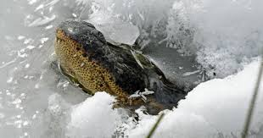
CHEMISTRY OF WATER
Essential to all living organisms
Cohesive
Molecules cling together (hydrogen bonding), allows water to flow freely
Adhesive
Molecules cling to other surfaces, allows transport through vessels in body
Higher density than ice
Ice floats, insulates water underneath preventing freezing throughout

Slide 28
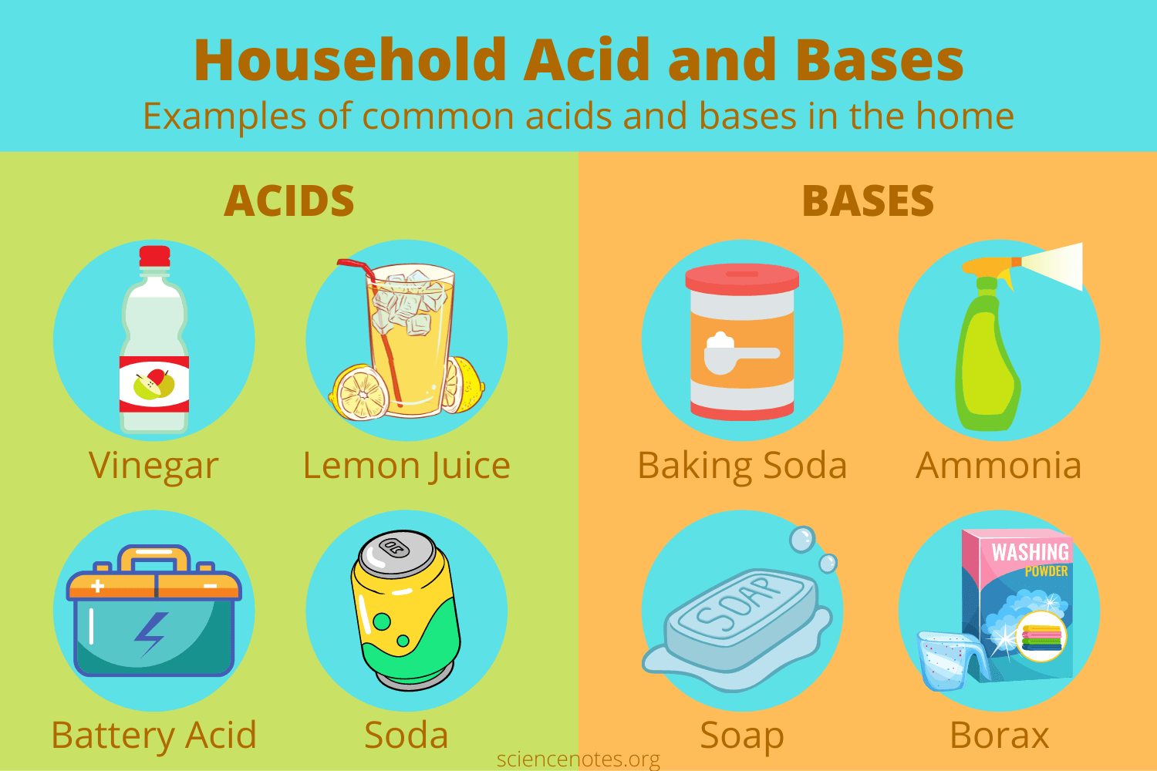
Acids and bases
Acids
High h+ concentration
Release hydrogen ions (h+) when mixed with water
Taste sour, burning sensation
Bases
Low h+ concentration
Release hydroxide ions (oh⁻) when mixed with water
Can take up hydrogen ions (h⁺)
Taste bitter, Feel slippery

Slide 29
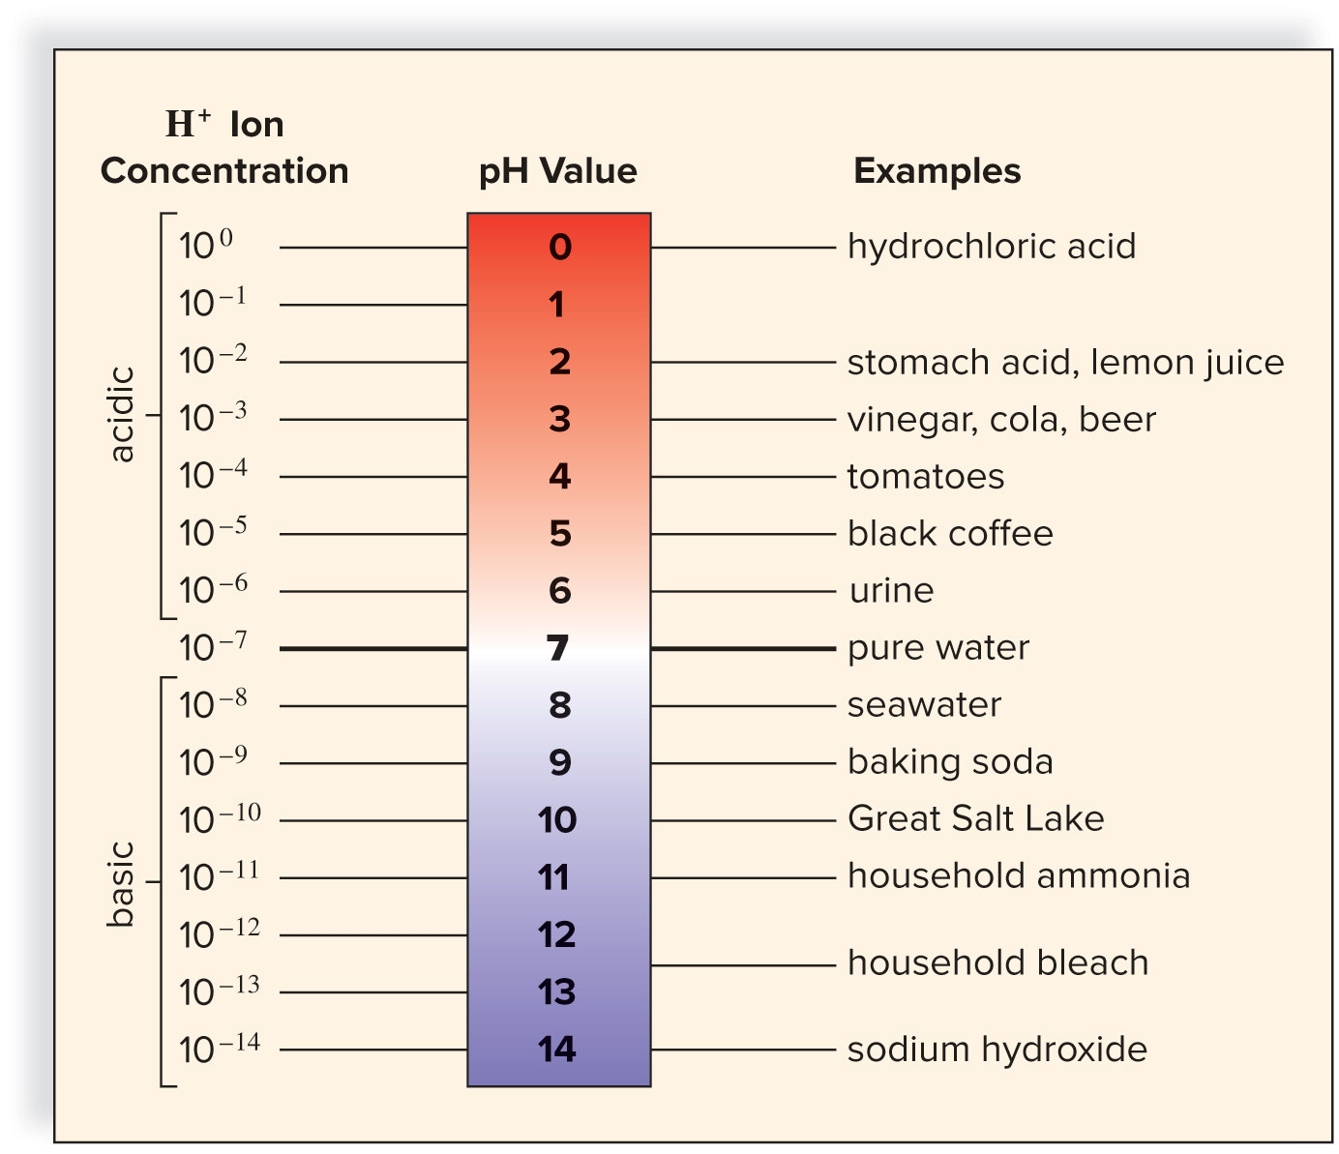
Ph scale
Indicates acidity or alkalinity of solution
Ranges of 0-14; Ph 7 = neutral
Acids – below 7; stronger towards 0
Bases – above 7; stronger towards 14
10-fold change each step
ph 2 is 10x stronger ph 3
ph 10 is 100x weaker than ph 12

Slide 30
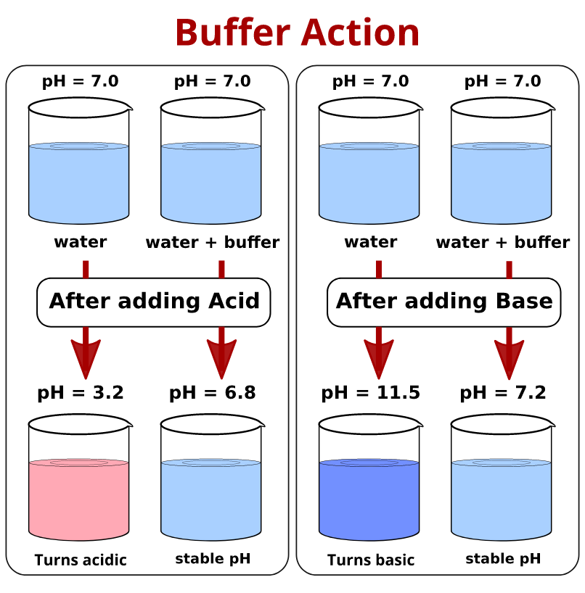
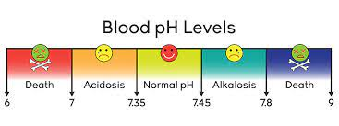
buffers
chemical that keeps ph within normal limits
Takes up excess H⁺ or OH⁻ ions
Necessary to maintain constant ph in blood

Slide 31
possible teas questions
which of the following descriptions is correct?
solid – no constant volume and no constant shape
liquid – no definite volume and constant shape
gas – no definite volume and no definite shape
gas – constant volume and a definite shape
which of the following is true about hydrogen bonds?
they are considered strong attractive forces
they result from the attraction between ions that have no charge
they don’t affect the properties of water in any way
they form between a partial positively charged region on one molecule and the partial negatively charged region on another molecule

Slide 32
possible teas questions
which of the following descriptions is correct?
solid – no constant volume and no constant shape
liquid – no definite volume and constant shape
gas – no definite volume and no definite shape
gas – constant volume and a definite shape
which of the following is true about hydrogen bonds?
they are considered strong attractive forces
they result from the attraction between ions that have no charge
they don’t affect the properties of water in any way
they form between a partial positively charged region on one molecule and the partial negatively charged region on another molecule

Slide 33
possible teas questions
which of the following compounds are ionic?
NH₃
NCl₃
Kcl
MgCL₂
Which of the following properties of water allows pond insects like water striders to walk across its surface without sinking?
density
osmosis
hydrogen bonding
London dispersion forces

Slide 34
possible teas questions
which of the following compounds are ionic?
NH₃
NCl₃
Kcl
MgCL₂
Which of the following properties of water allows pond insects like water striders to walk across its surface without sinking?
density
osmosis
hydrogen bonding
London dispersion forces

